Slide 1


Finding Green Lanterns How to Fund Big Data for Civil Infrastructure Research
Joshua M. Peschel, Ph.D. Assistant Professor and Black & Veatch Faculty Fellow Agricultural and Biosystems Engineering Civil, Construction and Environmental Engineering (Courtesy)
North Carolina State University – January 22, 2018

Slide 2
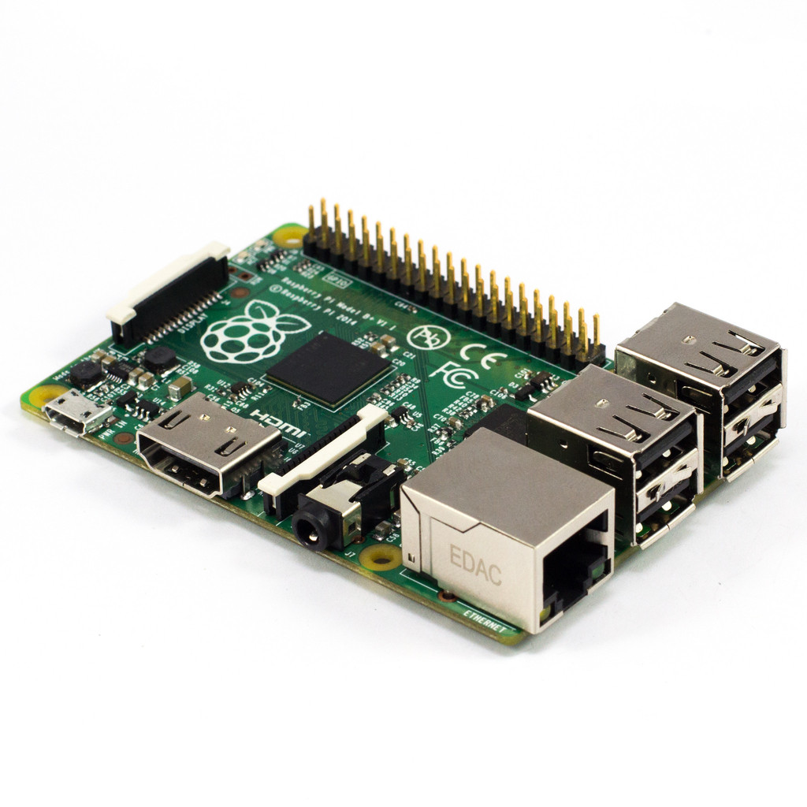
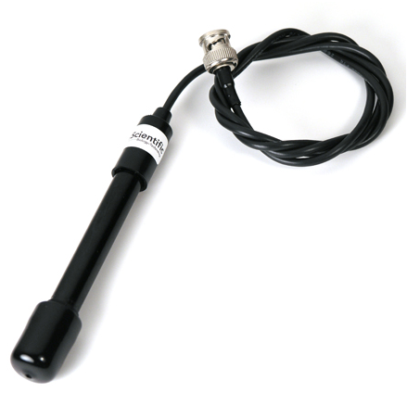


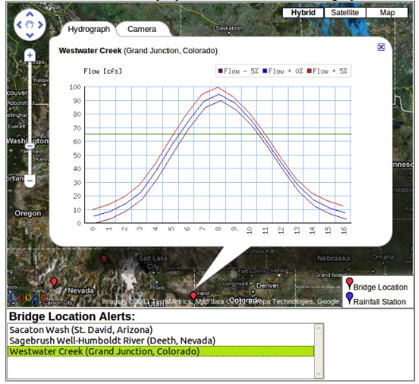
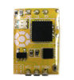
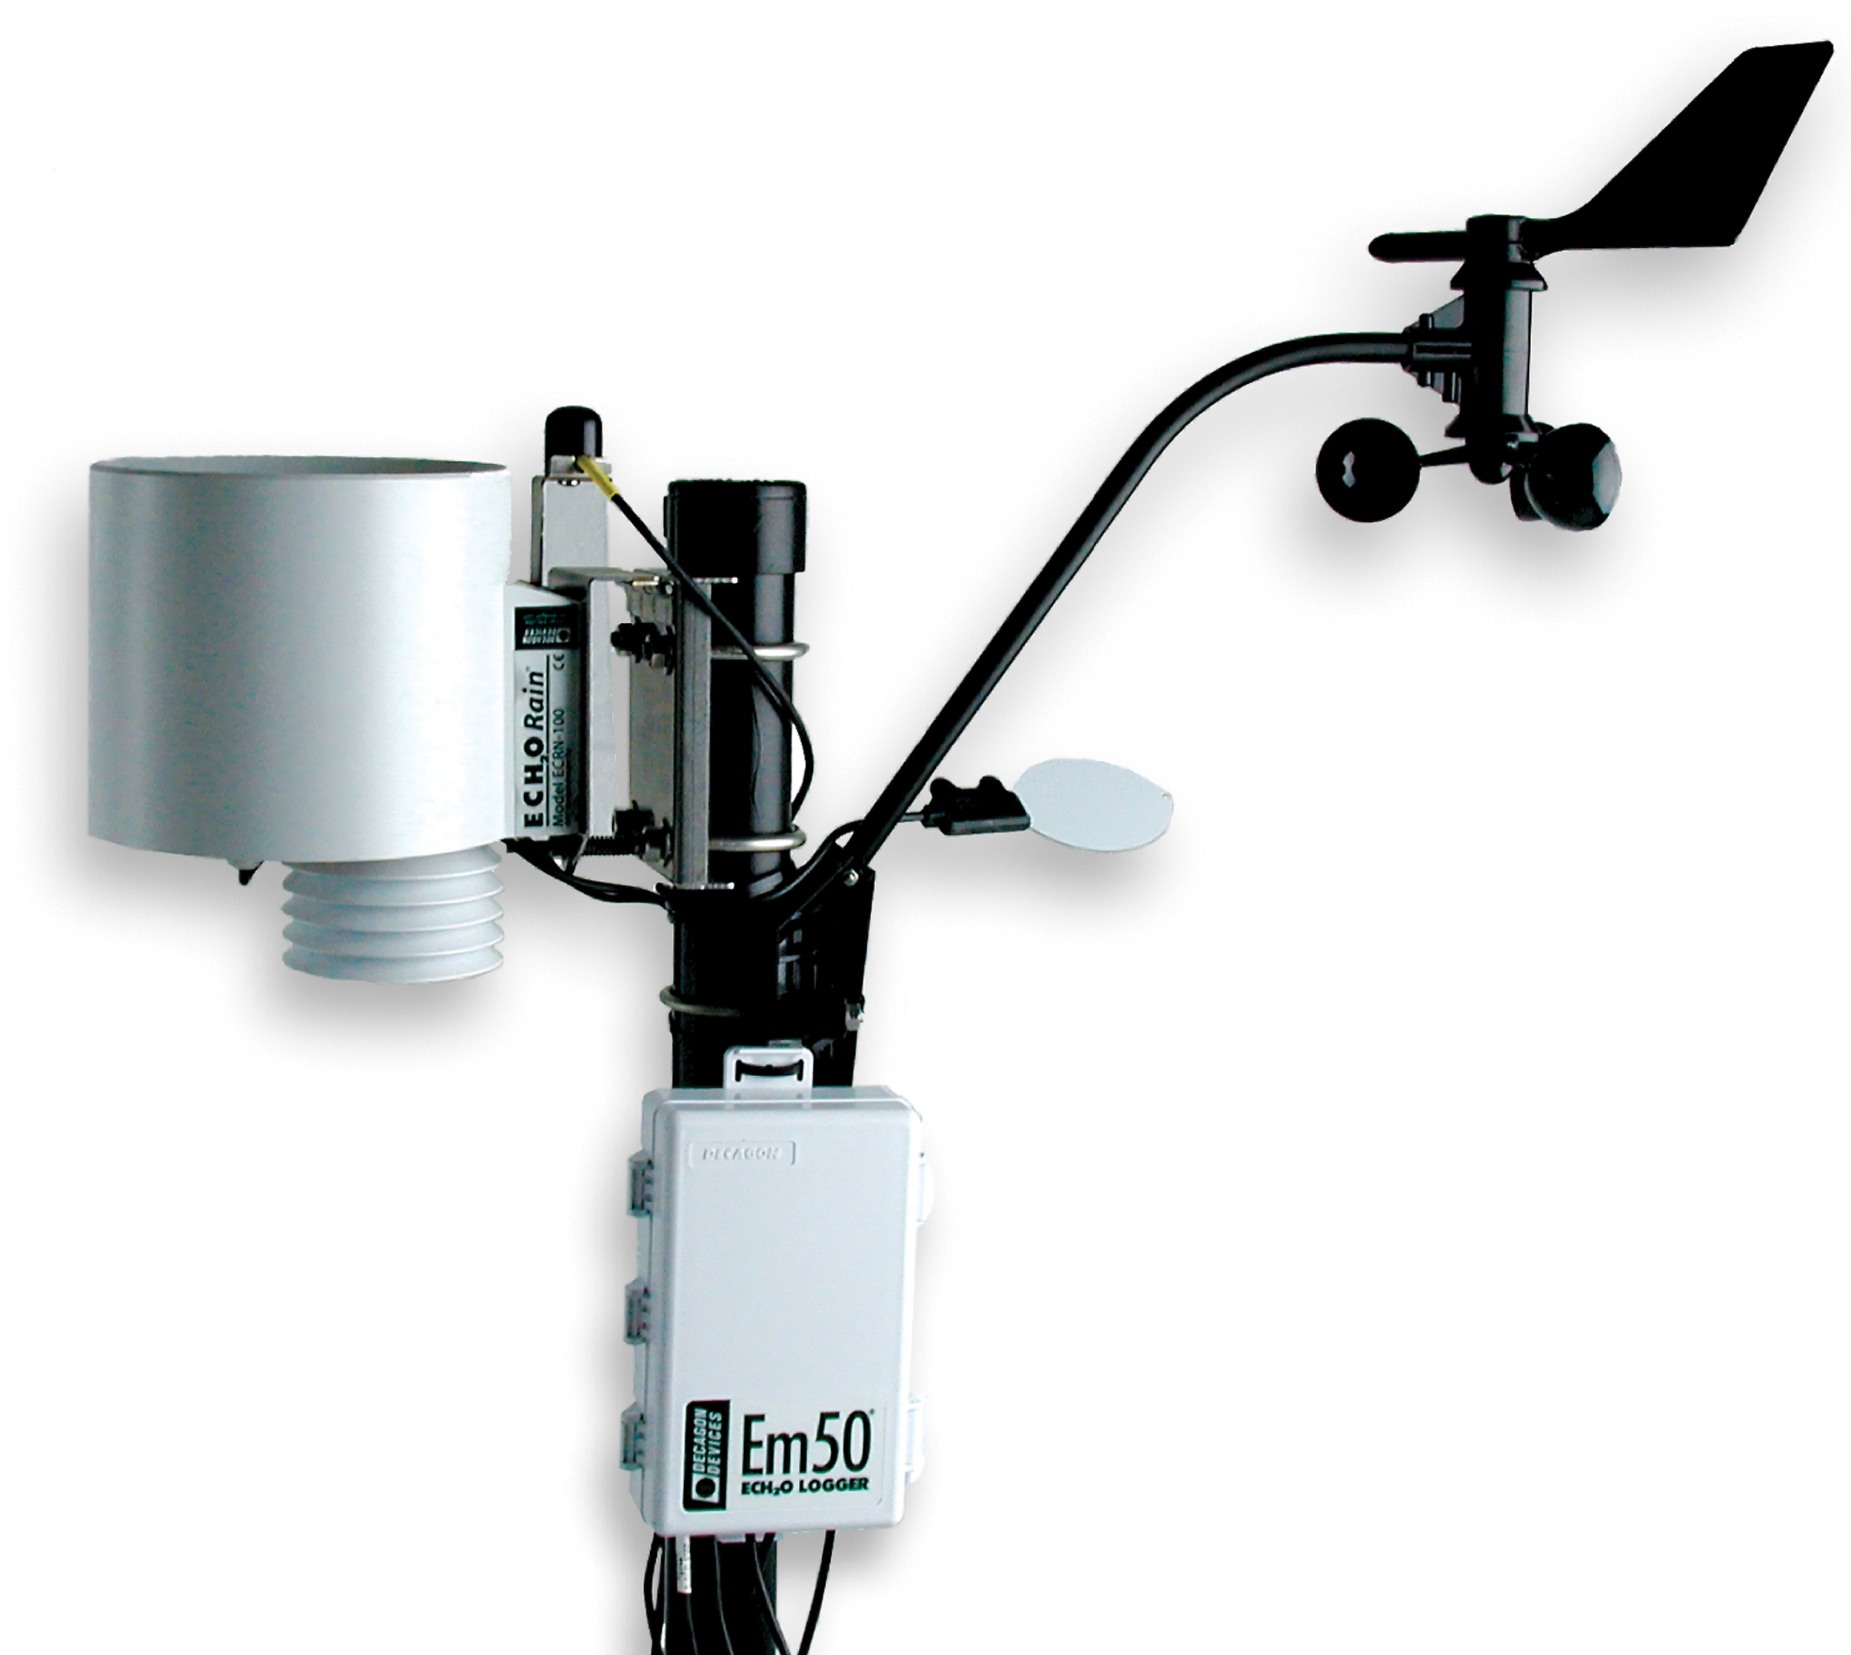

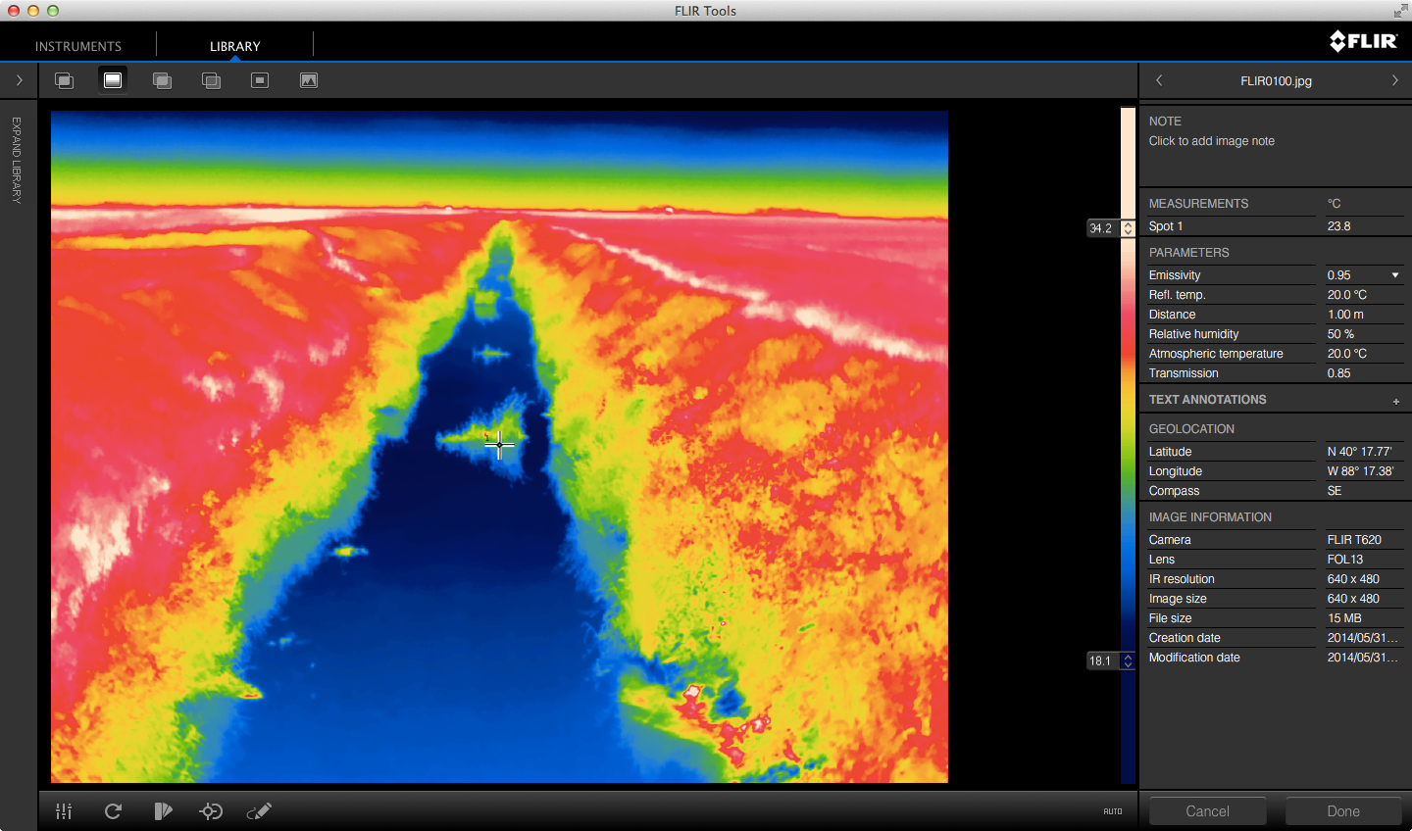



Research Worldview
Human-Infrastructure Interaction
Sensing
Store and Stir
Sense-Making
Do X
Do X or Y
Do X, Y, Z

Slide 3
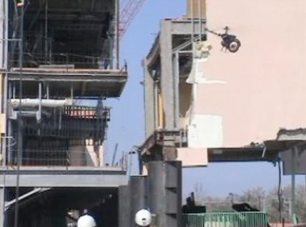
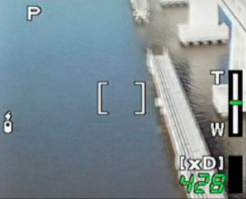
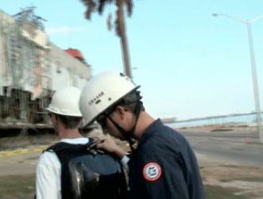
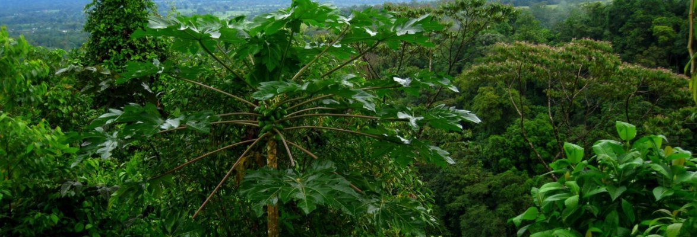
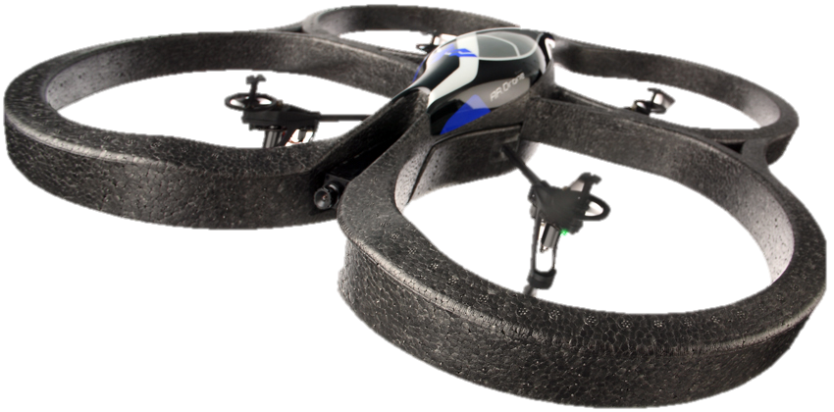
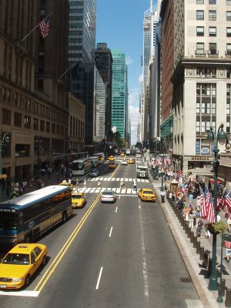
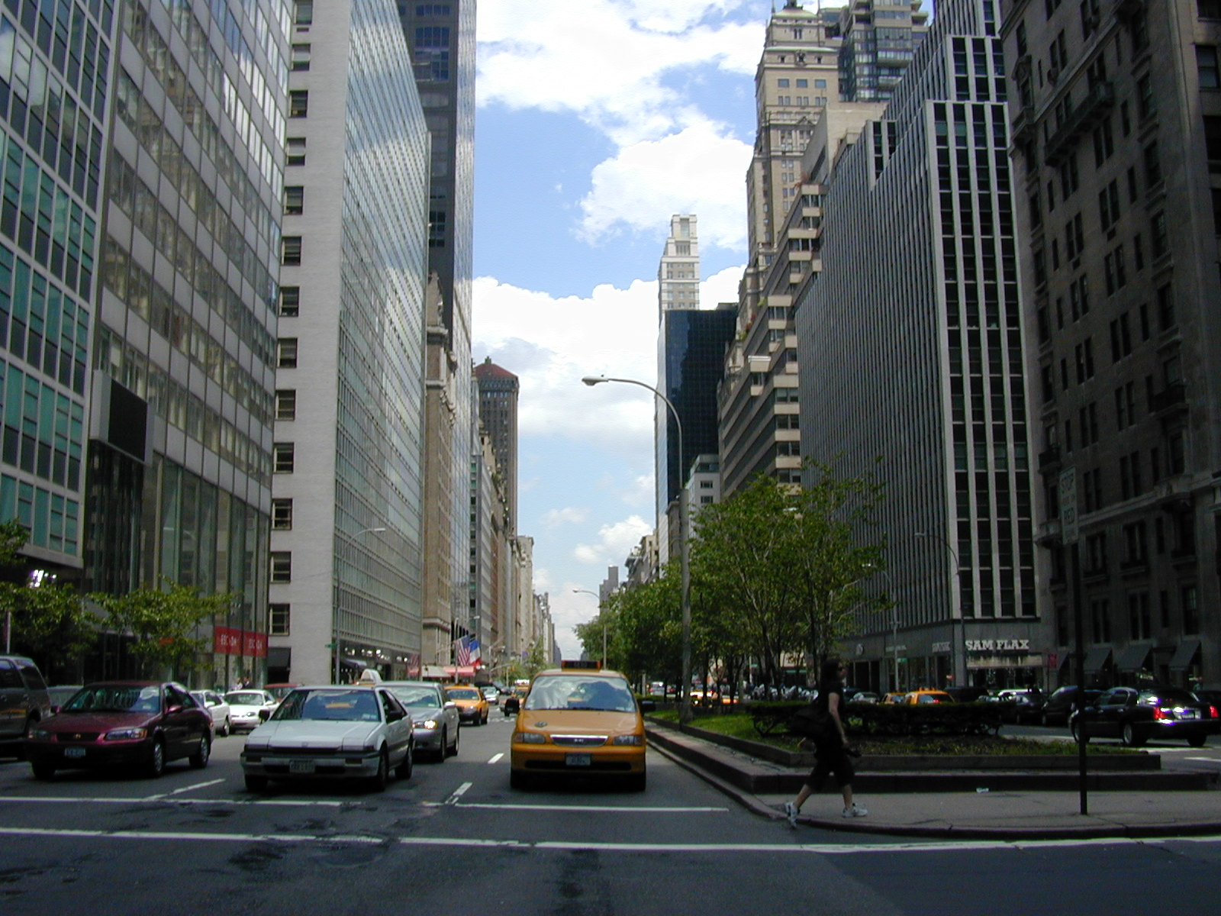
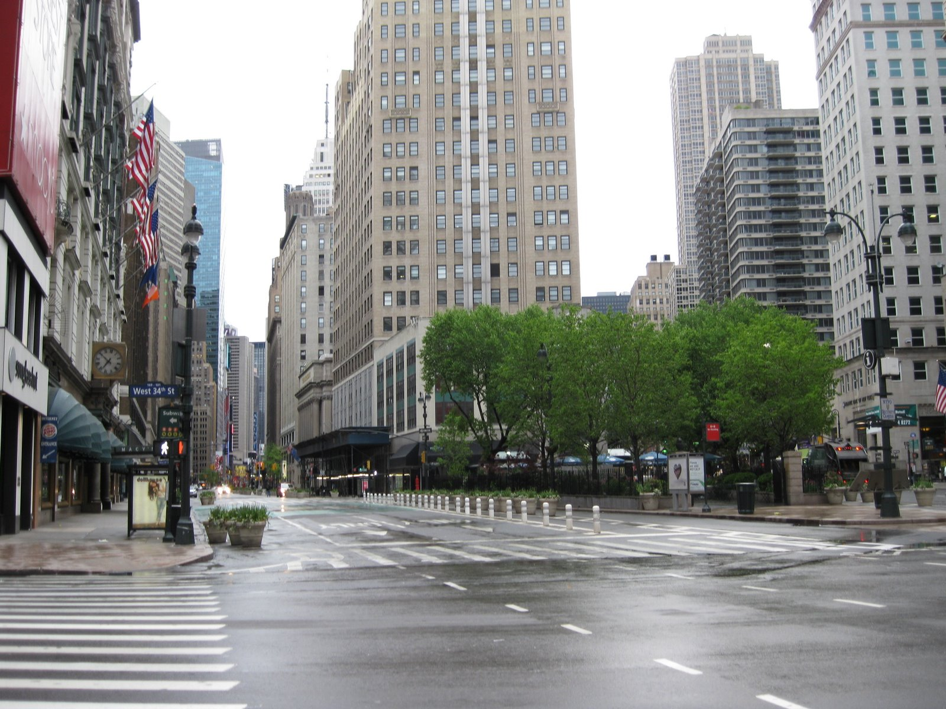
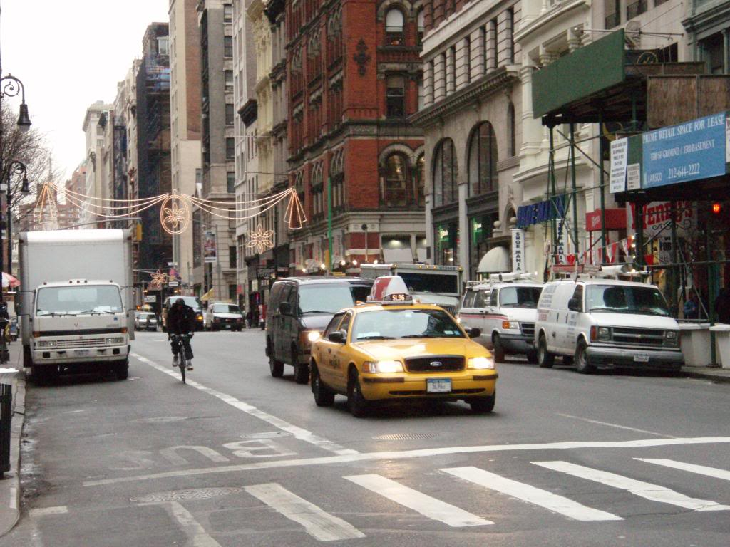
Current Research Activities
Post-Disaster Response¹⁻³
• small UAVs used for inspection
• response teams are ad hoc
• human-robot interfaces are key
Environmental Hydrology⁴
• energy-water measurements lacking
• several barriers to measurement
• physical object interaction necessary
Transportation Monitoring
• errors in traffic system estimation
• problem streets/roads not known
• robot acts as traffic state filter
[1] J.M. Peschel and R.R Murphy (2013). On the Human-Machine Interaction of Unmanned Aerial System Mission Specialists. IEEE Transactions on Human-Machine Systems.
[2] J.M. Peschel, B.A. Duncan and R.R. Murphy (2013). A Mission Specialist Interface for Small Unmanned Aerial Systems. IEEE Transactions on Human-Machine Systems, in review.
[3] R.R. Murphy, J.M. Peschel, C. Arnett and D. Martin (2012). Projected Needs for Robot-Assisted Chemical, Biological, Radiological, or Nuclear (CBRN) Incidents. In Proceedings of the 10th IEEE International Symposium on Safety, Security, and Rescue Robotics (SSRR ’12) (Nominated for Best Paper Award).
[4] J.M. Peschel (2012). Towards Physical Object Manipulation by Small Unmanned Aerial Systems. In Proceedings of the 10th IEEE International Symposium on Safety, Security, and Rescue Robotics (SSRR ’12) (Invited Paper).

Slide 4
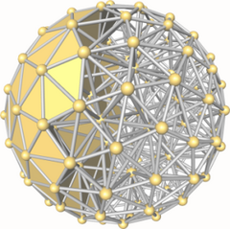
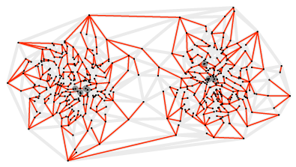
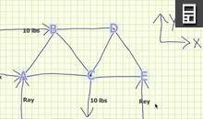
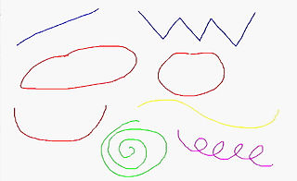

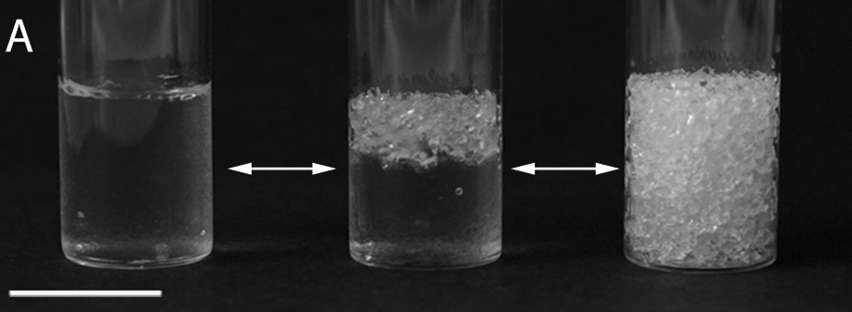
Current Research Activities (2)
Computational Geometry
• fair partitioning of polygons
• approximation algorithms
• wide applications
Sketch Recognition¹⁻⁴
• computers learn what we draw
• algorithms and systems
• engineering education applications
Computer Vision
• soil-structure interaction
• looking inside soils
• shear strength of the material
[1] Hammond, T., D. Logsdon, J.M. Peschel, J. Johnston, P. Taele, A. Wolin and B. Paulson. 2010. A Sketch Recognition System for Recognizing Free-Hand Course-of-Action Diagrams. In Proceedings of the 22nd Conference on Innovative Applications of Artificial Intelligence (IAAI 2010), Atlanta, Georgia. (Acceptance Rate: 39%).
[2] J.M. Peschel and T. Hammond. (2010). A Pen-Based Approach for Water Resources Model User Interfacing. AWRA GIS and Water Resources VI, Orlando, Florida.
[3] J.M. Peschel, B. Paulson and T. Hammond. (2009). A Surfaceless Pen-Based Interface. In Proceedings of the 7th ACM SIGCHI Annual Conference on Creativity and Cognition, Berkeley, California.
[4] J.M. Peschel and T. Hammond. (2008). STRAT: A Sketched-Truss Recognition and Analysis Tool. In Proceedings of the Visual Languages and Computing (VLC) Special Session on Sketch Computing, Boston, Massachusetts.

Slide 5
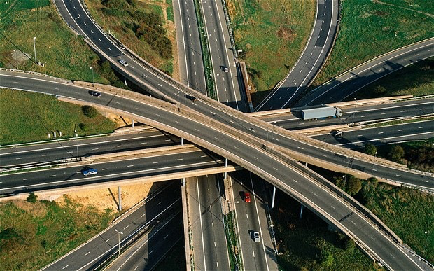
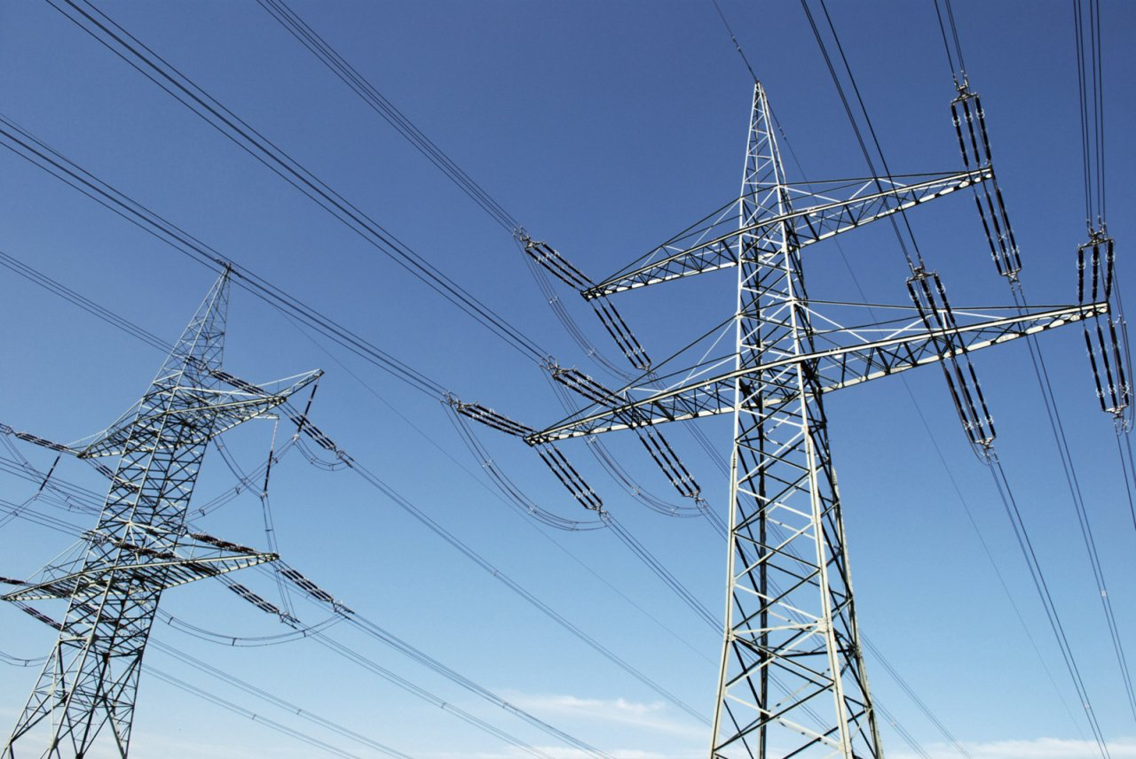
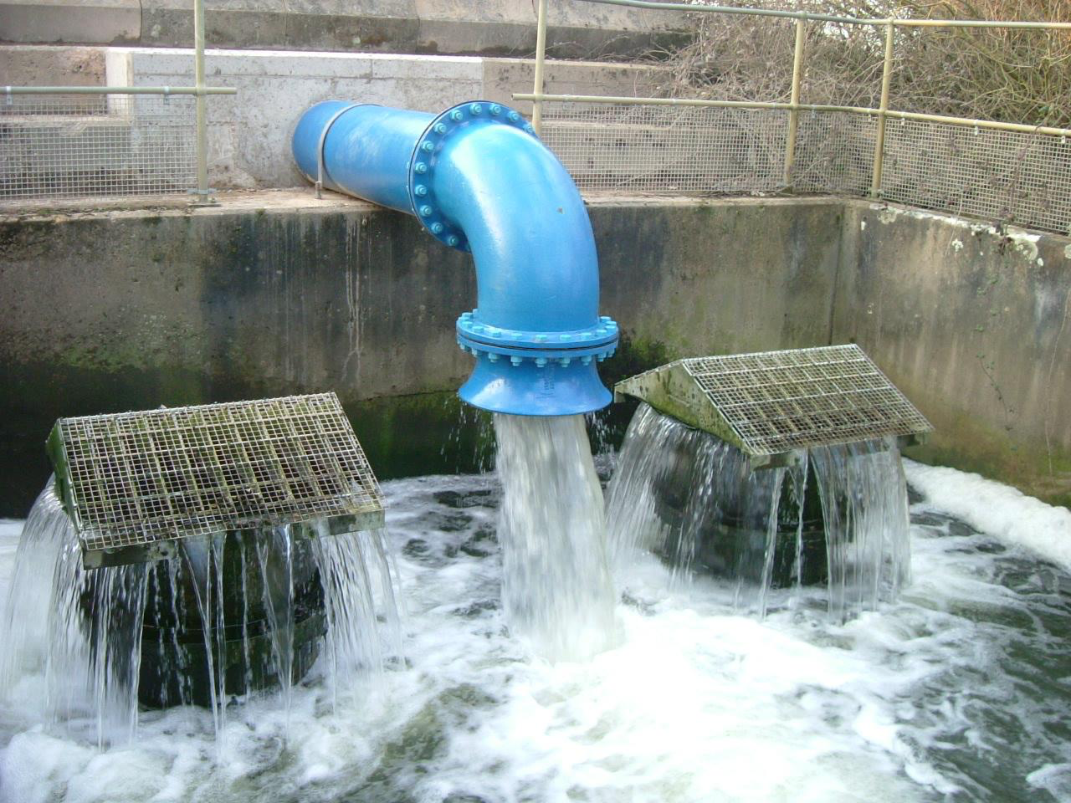
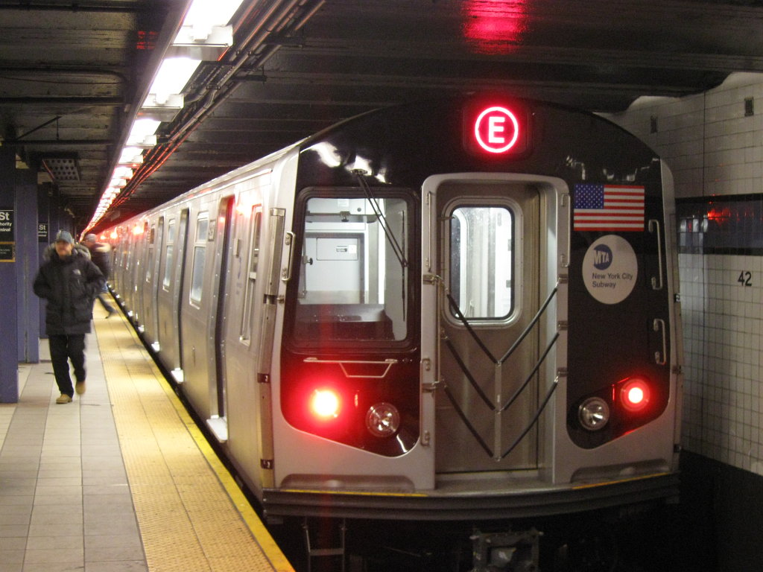
The Problem: Public Goods
“a commodity or service that is provided without profit to all members of a society, either by the government or a private individual or organization.”

Slide 6
Smart Green Infrastructure

Slide 7
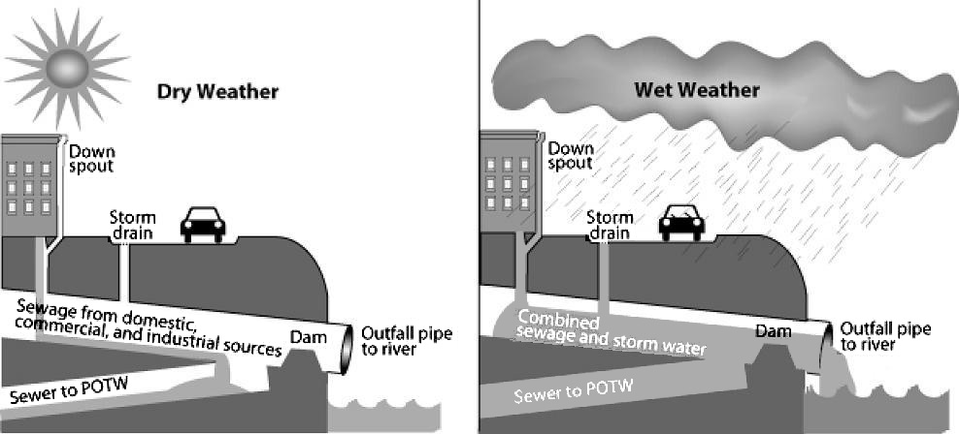
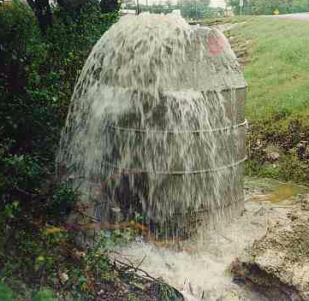
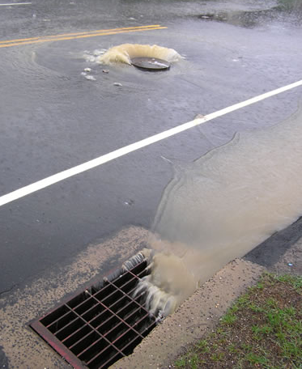
Motivation
Changes to Infrastructure and Climate Impact Surface Runoff
• impervious surfaces captures larger volumes of precipitation
• larger storm events result in larger runoff volumes
Surface Runoff Changes Impact Combined Sewer Overflow
• dry weather conditions generally do not present a problem
• wet weather conditions can cause a CSO to occur
There are No Low-Cost Methods to Quantify CSO Outflow
• sensing systems require investment in proprietary hardware and software
• existing camera infrastructure can leverage computer vision algorithms

Slide 8
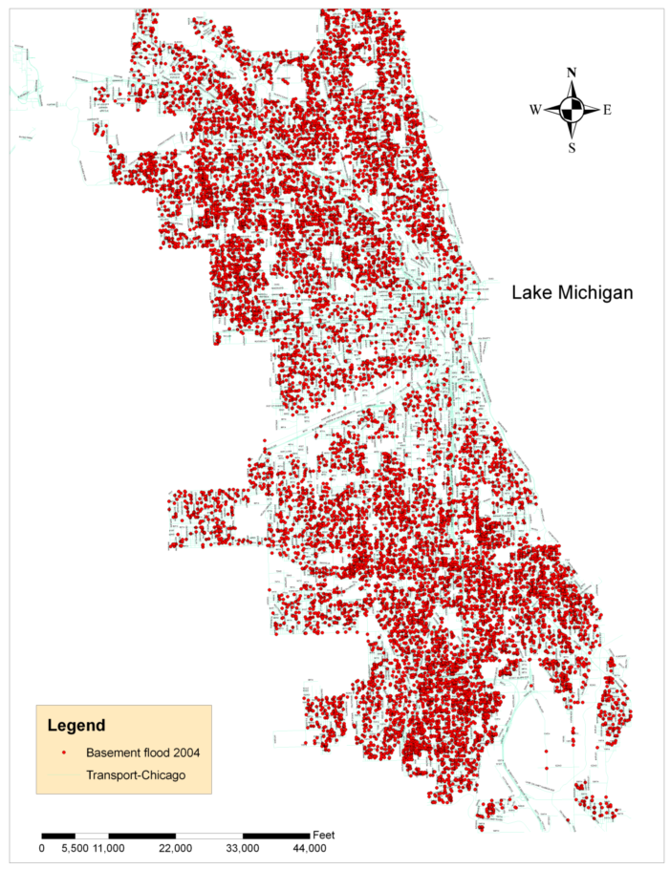
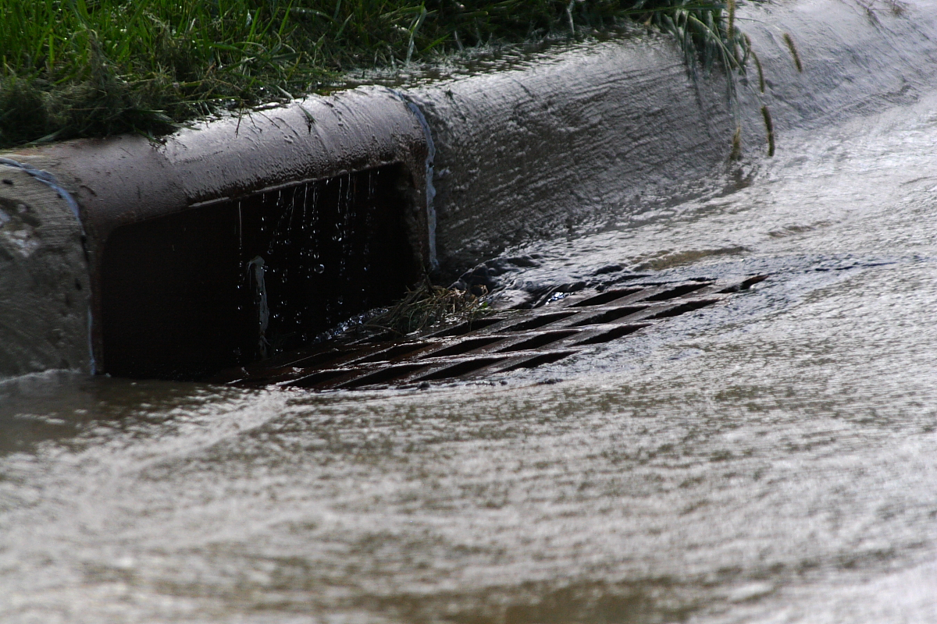
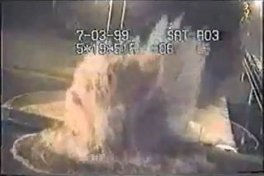

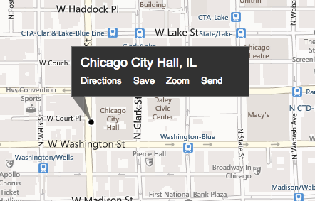


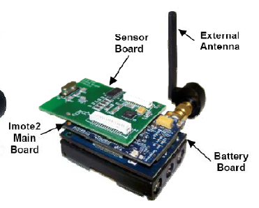
Water Problems in Chicago
Drainage
Overflow
Stormwater flow monitoring via low-cost sensor networks and social networking. This will substantially improve modeling, warnings, and will lead to solutions.
Basement flooding complaints documented in Chicago during 2004

Slide 9
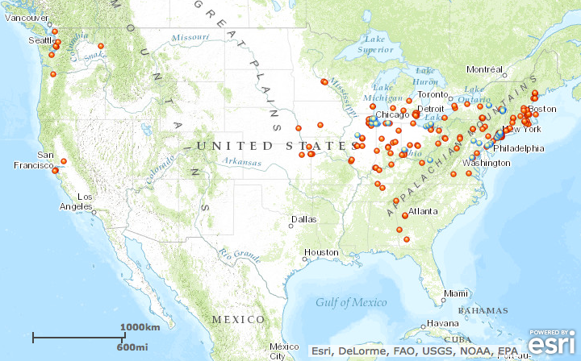
Water Problems Elsewhere

Slide 10
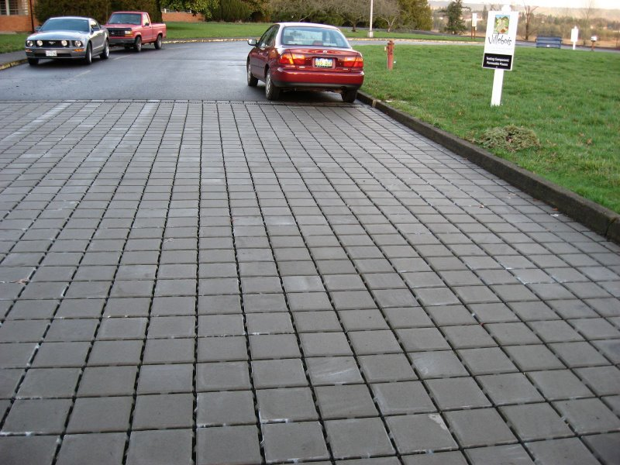
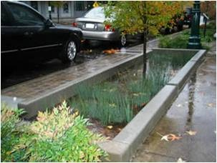
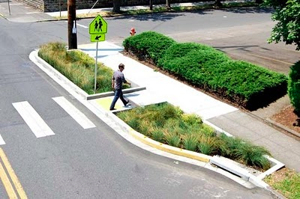
What is Green Infrastructure?
Green infrastructure uses elements of vegetation, soils, and natural processes to manage water and create healthier urban environments.
Permeable Pavers
Infiltration Planters
Infiltration Bumpouts
In most urban areas, stormwater is drained through engineered collection systems and discharged into nearby waterways; trash, bacteria, heavy metals, and other pollutants from the urban landscape can all be included in the discharge.

Slide 11
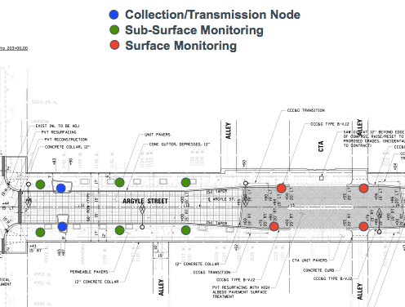
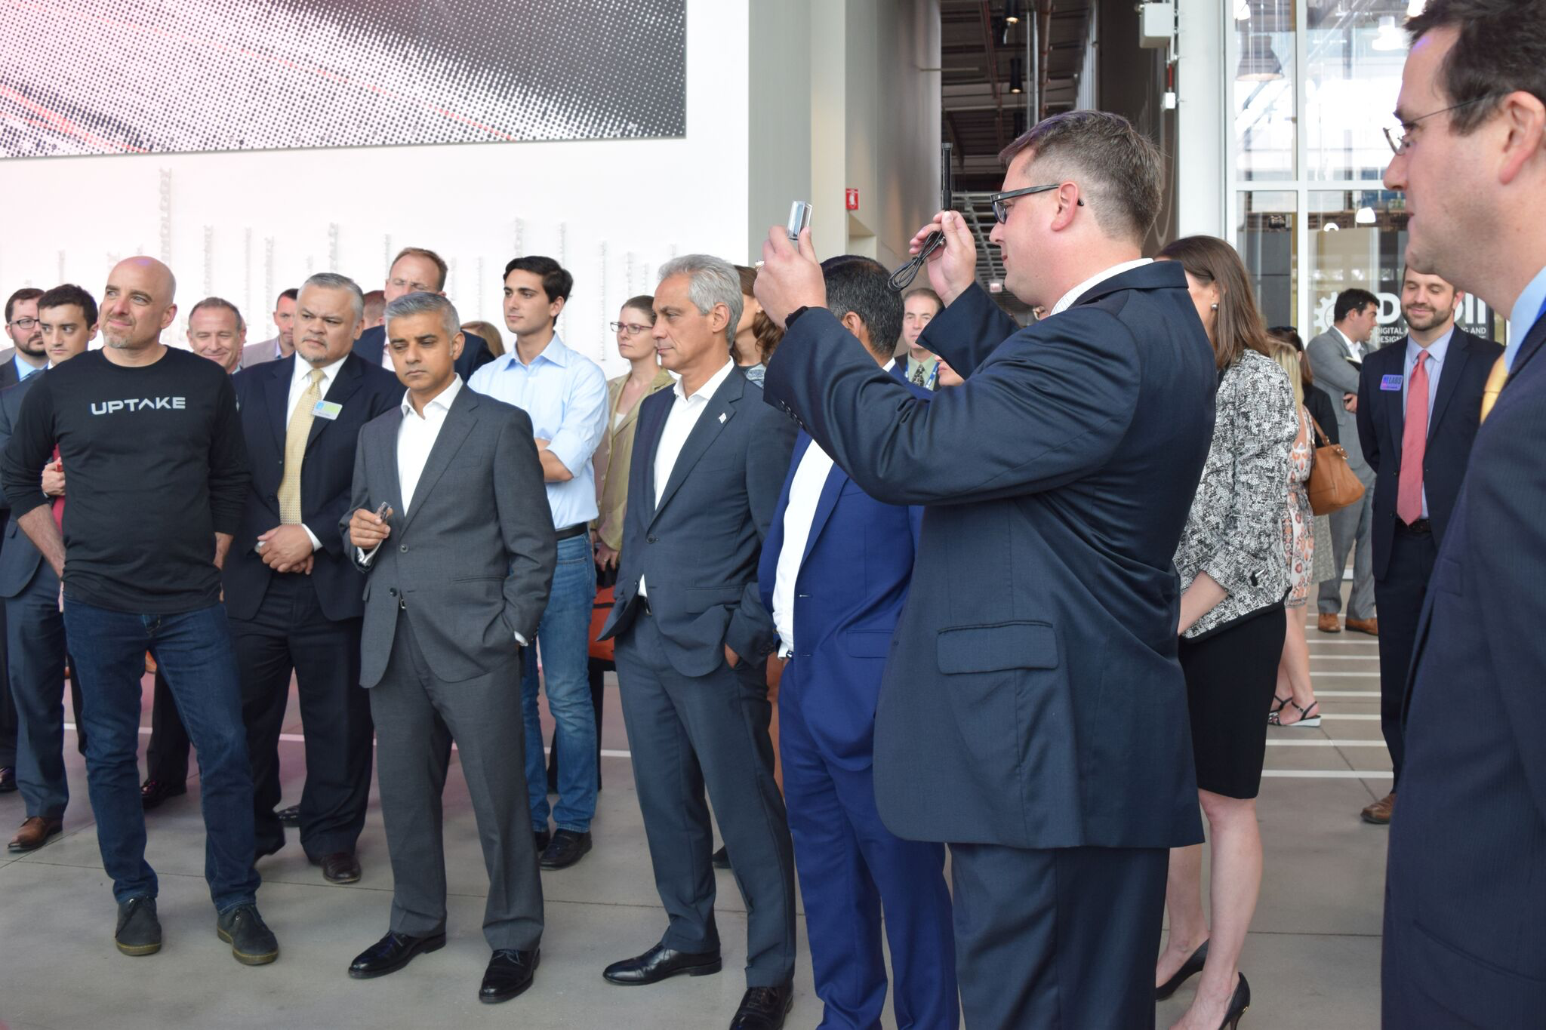
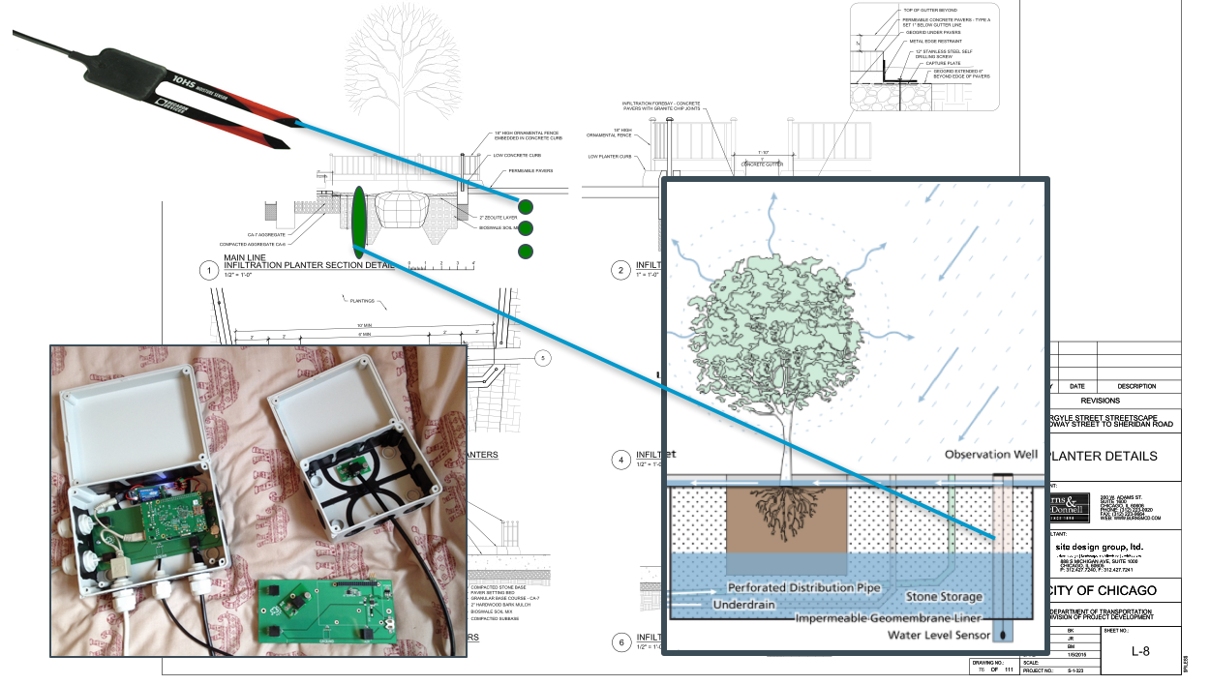
Pilot Streetscape Monitoring Sites

Slide 12
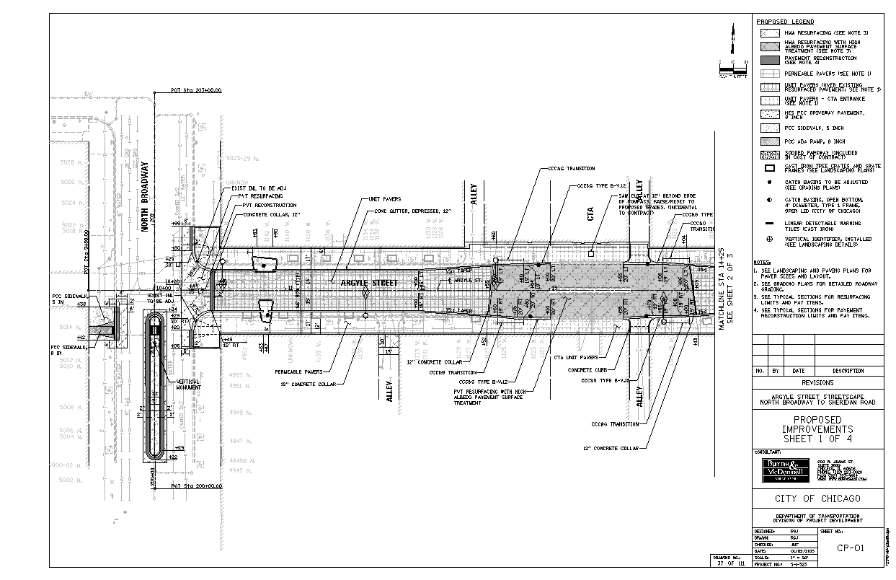
Pilot Streetscape Monitoring Sites
Collection/Transmission Node
Sub-Surface Monitoring
Surface Monitoring
802.11 Connection to Server

Slide 13
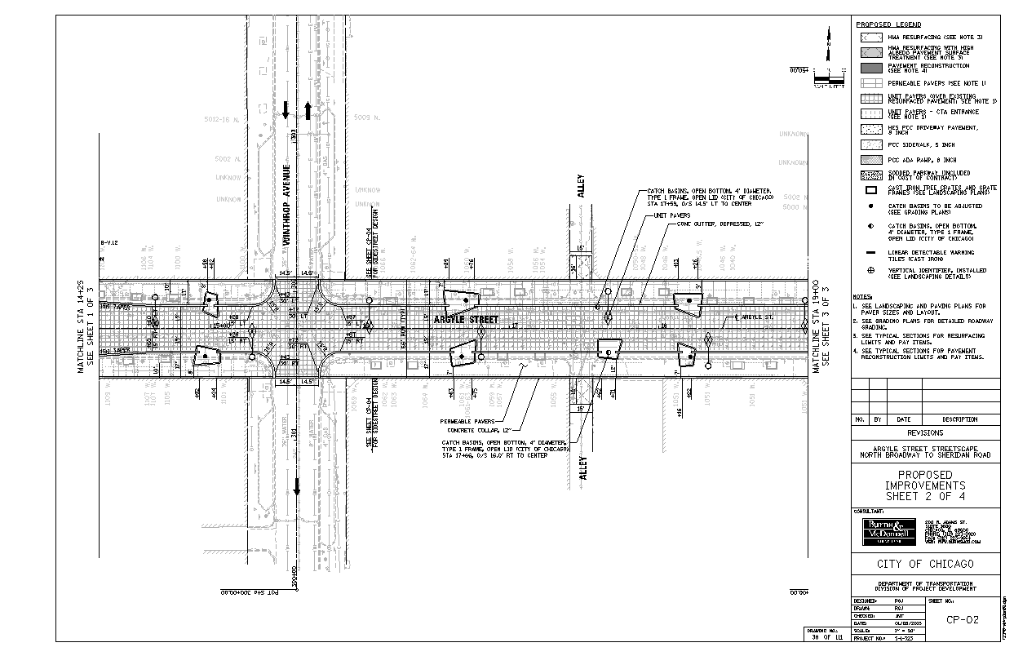
Pilot Streetscape Monitoring Sites (2)
Collection/Transmission Node
Sub-Surface Monitoring
Surface Monitoring

Slide 14
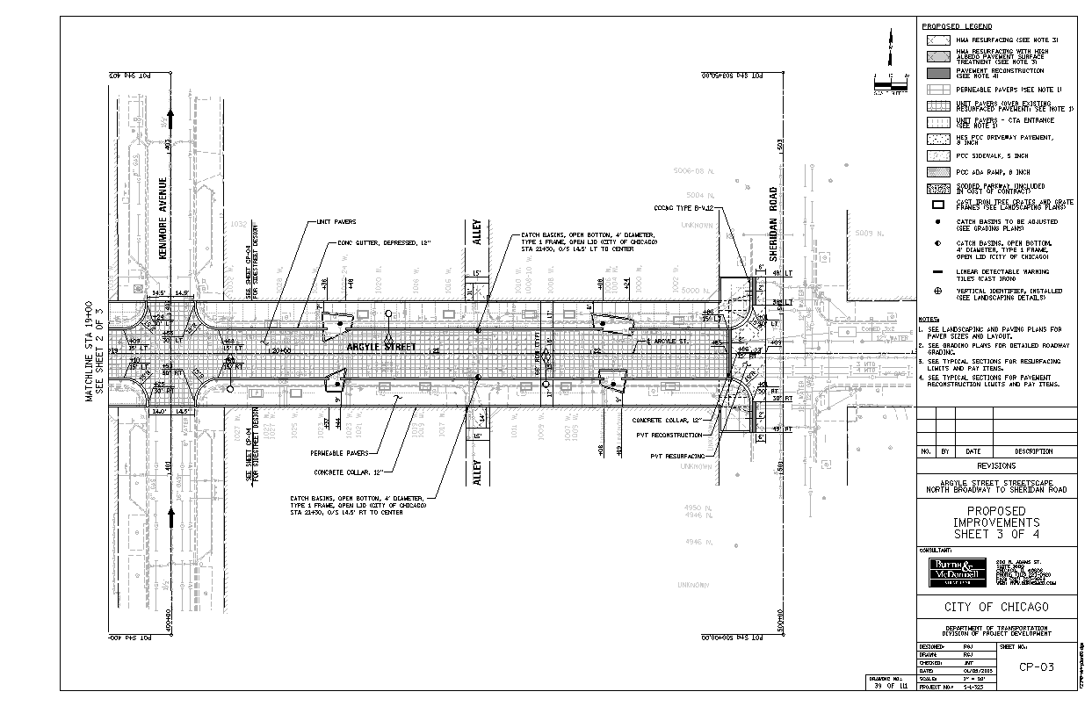
Pilot Streetscape Monitoring Sites (3)
Collection/Transmission Node
Sub-Surface Monitoring
Surface Monitoring

Slide 15
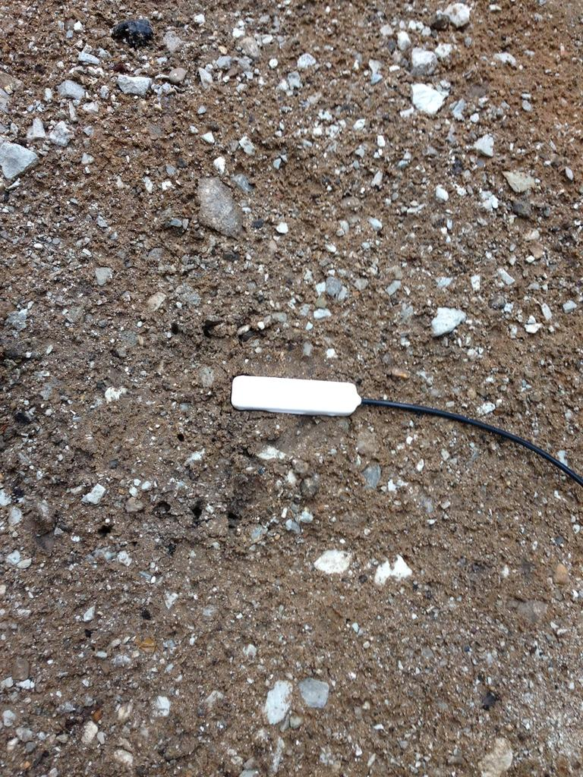
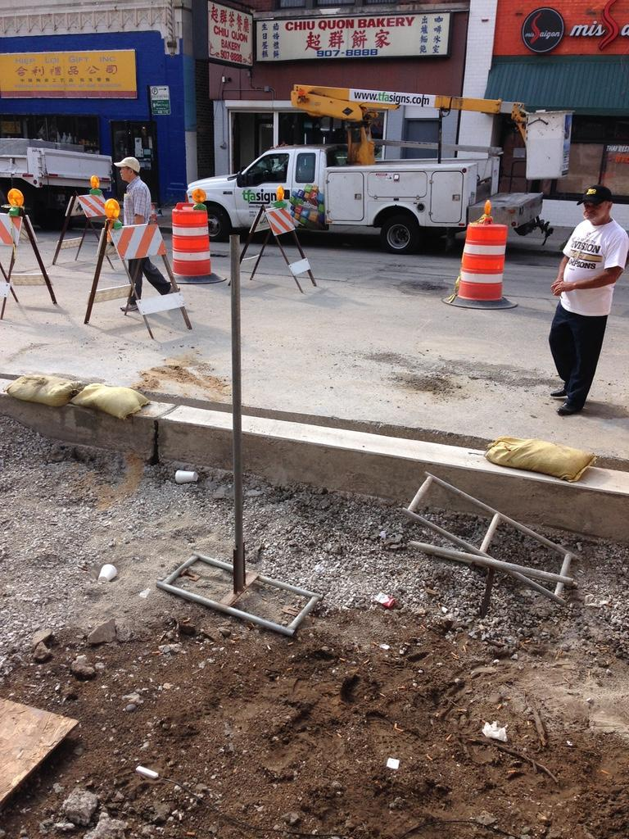
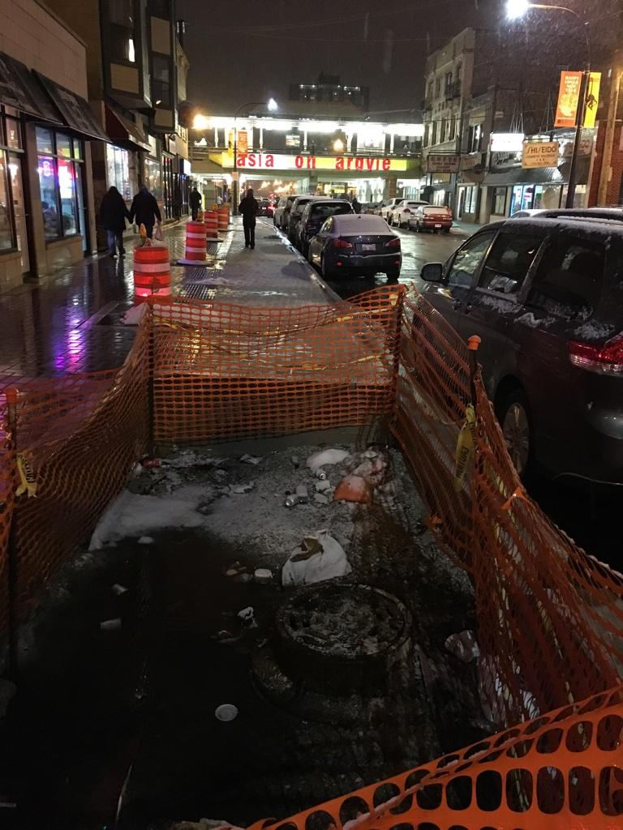
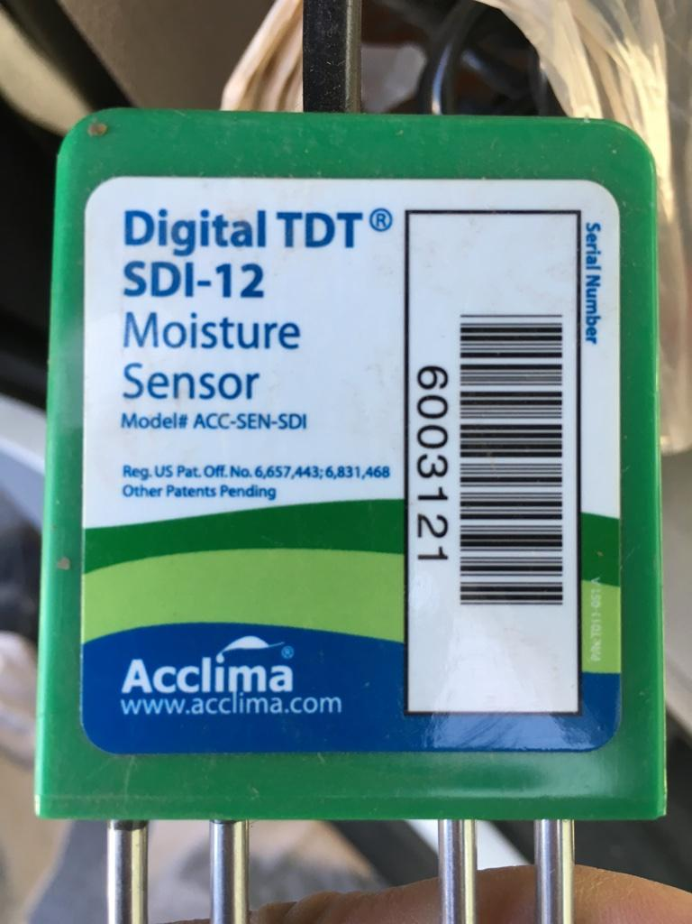
Pilot Streetscape Monitoring Sites (4)

Slide 16
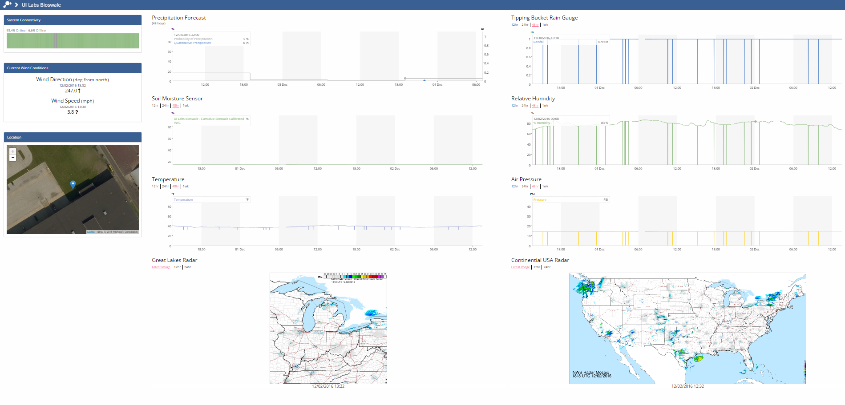
Visualization and Sense-Making

Slide 17
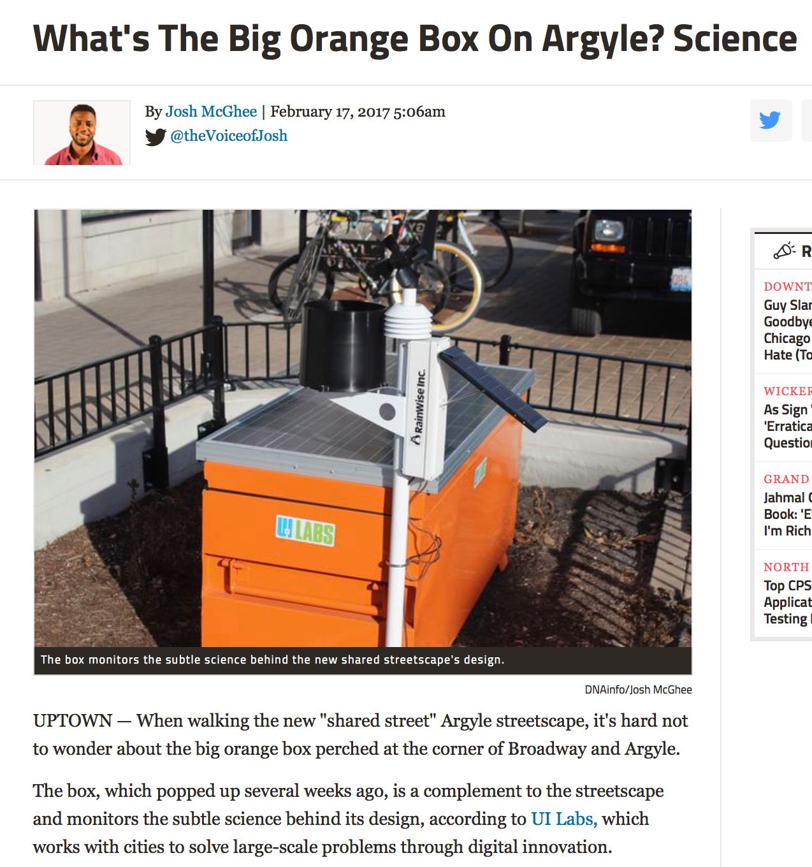

Slide 18
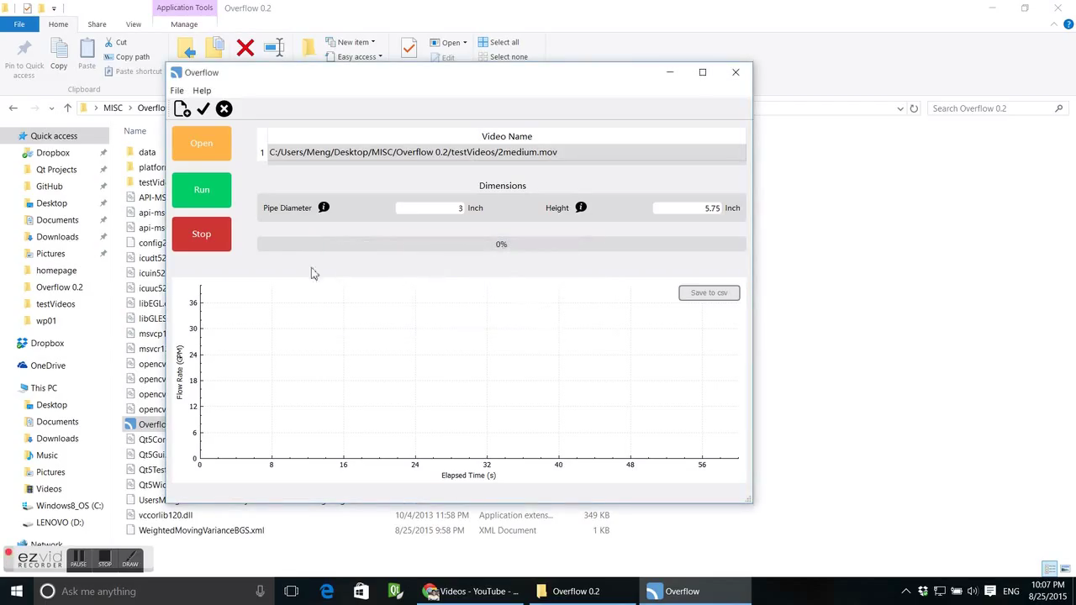
Visual Sensing

Slide 19
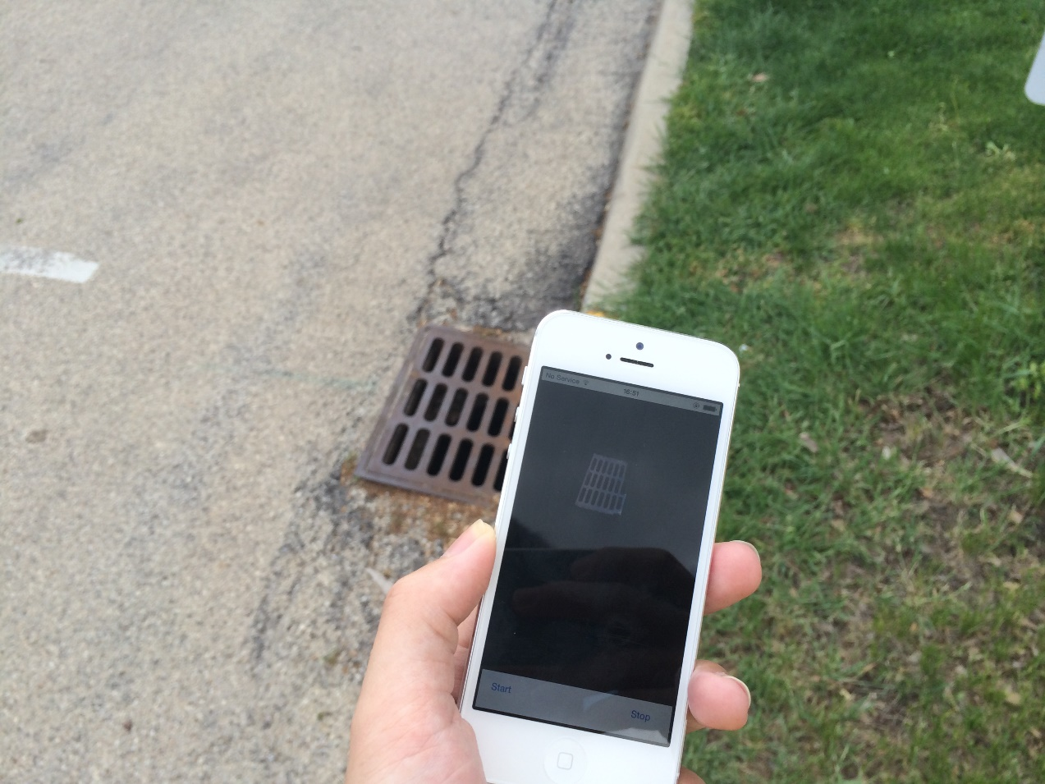


Visual Sensing (2)
Outdoor Field Testing of Algorithm on Mobile Devices
• placement of iOS and other devices (Rasp Pi) in natural lighting
• actively looking for pilot locations
Analysis of Prior Video Data and Existing Video Devices
• forensic analysis of video data that has already been captured
• evaluation for intersection/security, etc. cameras
Evaluation of Inflows to Storm Drains
• recognition of different drain geometries
• improved understanding of drainage system states

Slide 20
How did Smart Green Infrastructure happen?

Slide 21


Slide 22


Slide 23


Slide 24


Slide 25


Slide 26
Recommendations

Slide 27
Recommendations
Demonstrate that the Idea/Science/Technology is Mature
• Investigators want to deploy instruments
• But they must not be too experimental (or consider leveraging)
Identify and Gain Support of an Internal Advocate
• Needs to be a decision-maker inside of an enterprise
• Must provide a significant benefit to the goals of that person(s)
Leverage Economic Forces in Support of this Activity
• Combines both strategic and tactical aspects
• This is where you really have to do your homework

Slide 28









Funding Acknowledgements
Global Quality Corp.

Slide 29
Finding Green Lanterns How to Fund Big Data for Civil Infrastructure Research
Joshua M. Peschel, Ph.D. Assistant Professor and Black & Veatch Faculty Fellow Agricultural and Biosystems Engineering Civil, Construction and Environmental Engineering (Courtesy)
North Carolian State University – January 22, 2018

